Slide 1
Become a Pioneer for the Teaching Profession through National Board Certification
Mrs. Tasha Candela
tashacandela.weebly.com
@bethetigger
teachertasha@gmail.com

Slide 2
What is National Board Certification?

Slide 3
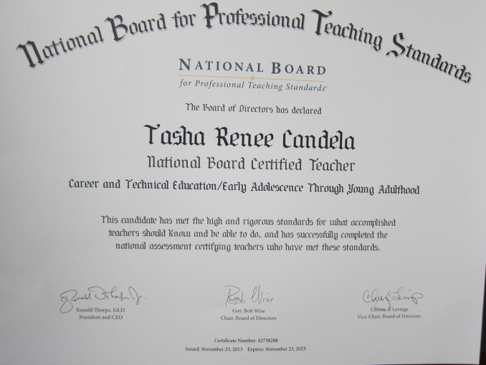
Certification Logistics
25 certificate areas from Pre-K−12th grades
$1,900 + $75 registration fee
$425 per entry
Financial assistance?
Local scholarship / $2,500 stipend
Good for 10 years
Advanced Professional Education Certificate

Slide 4
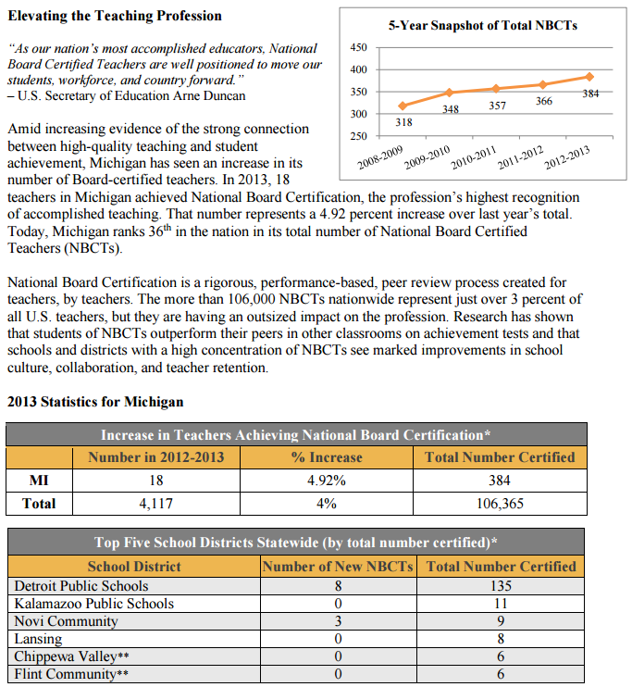
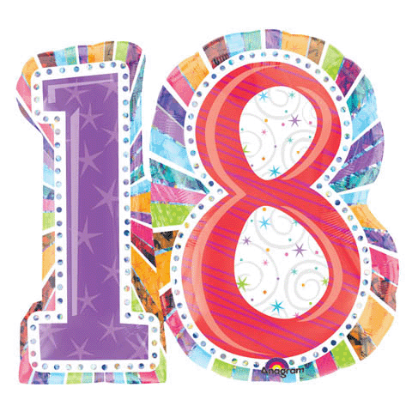
The Statistics

Slide 5
Breakdown
North Carolina (20,611) versus Michigan (391)
Washington (946) versus Michigan (18)
Peer support – Mentoring – Incentives - Recognition

Slide 6
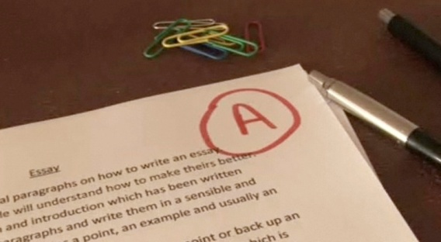
Overview
Four components
1) Field Tests(3+45)
2) Differentiated Instruction
3) Videotaped Lessons
4) Effective and Reflective Practitioner

Slide 7
Personal Journey

Slide 8
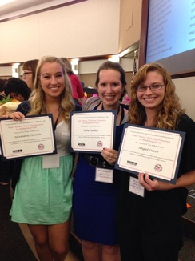
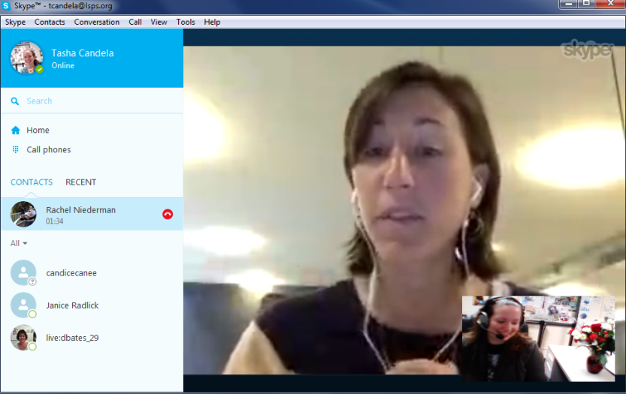
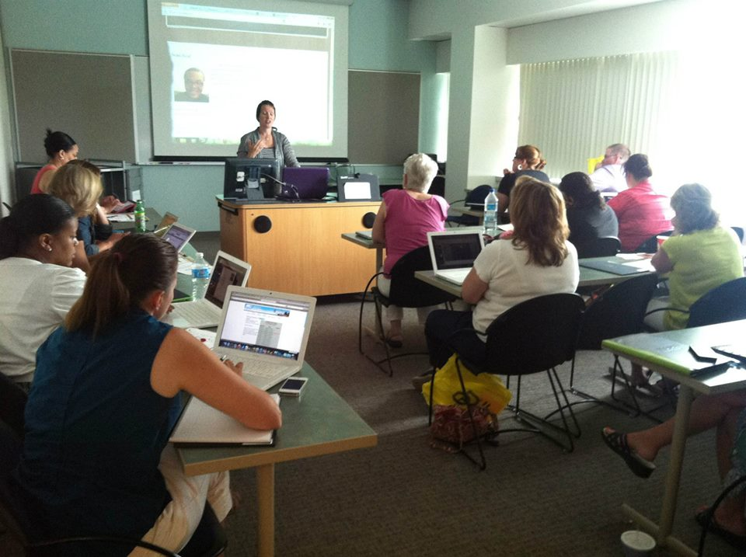
Get Inspired. Be Inspired.

Slide 9
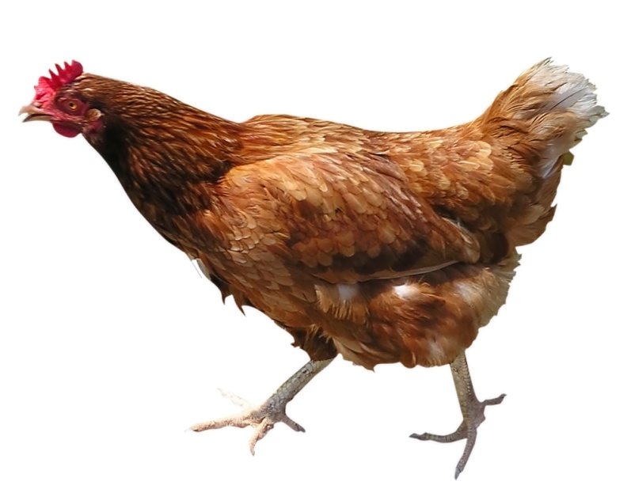
Don’t. Do.

