Slide 1
Candela’s Message
Who are you?
What is your role at LSHS?
What are you doing here?
Happiness.

Slide 2
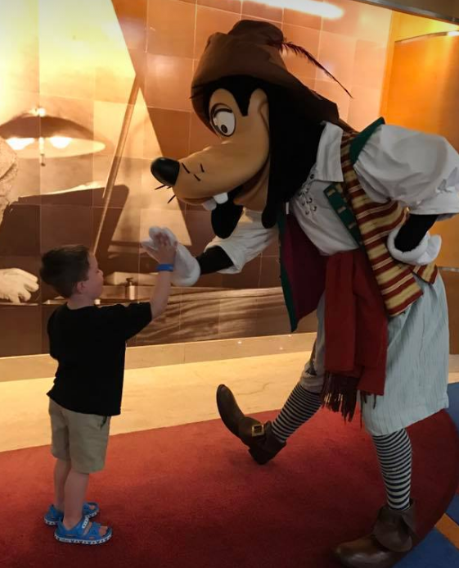
Candela’s Message
Dad.
Husband.
Son.

Slide 3
Candela’s Message
Acceptance.

Slide 4
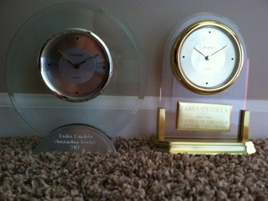
Candela’s Message

Slide 5
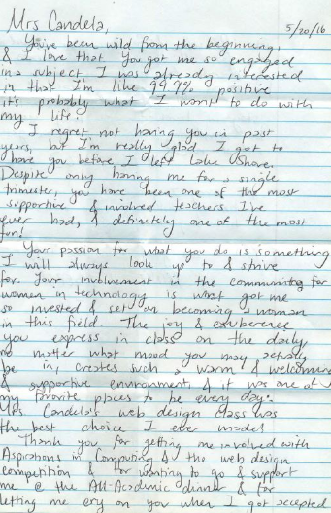
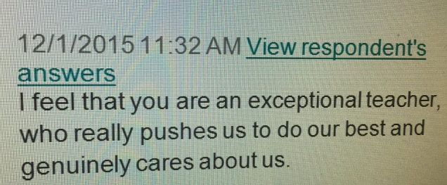
Candela’s Message

Slide 6
Candela’s Message
Survive.

Slide 7
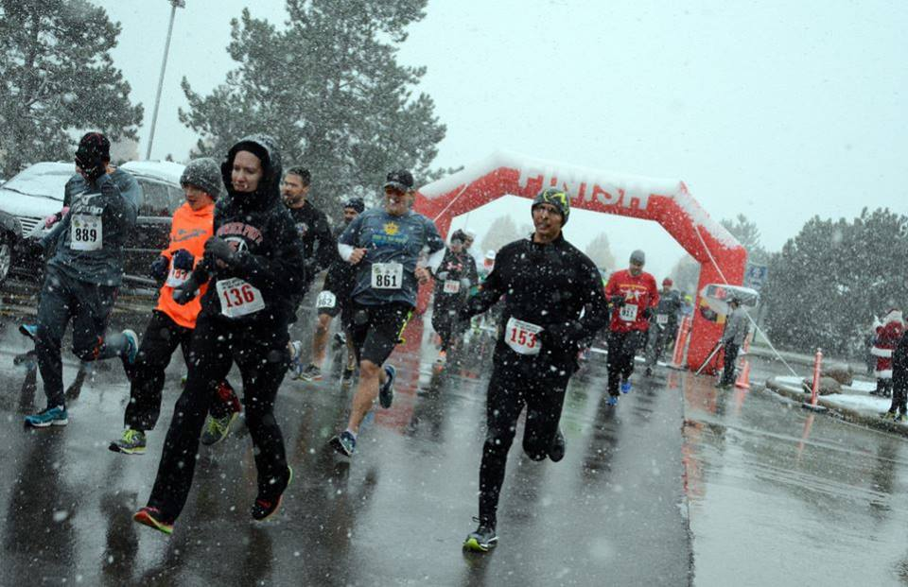
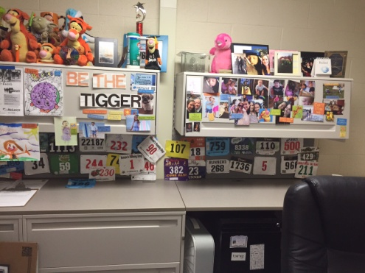
Candela’s Message

Slide 8
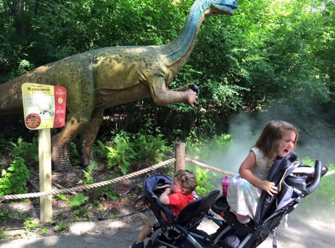
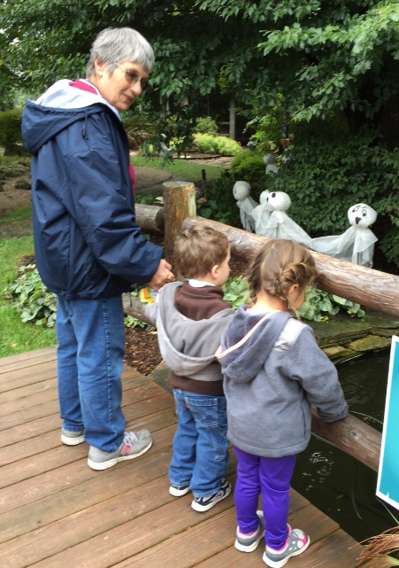
Candela’s Message

Slide 9
Candela’s Message
One day a farmer's donkey fell down into a well. The animal cried piteously for hours as the farmer tried to figure out a way to get him out. Finally he decided it was probably impossible and the animal was old and the well was dry anyway, so it just wasn't worth it to try and retrieve the donkey. So the farmer asked his neighbors to come over and help him cover up the well. They all grabbed shovels and began to shovel dirt into the well.
At first, when the donkey realized what was happening he cried horribly. Then, to everyone's amazement, he quieted down and let out some happy brays. A few shovel loads later, the farmer looked down the well to see what was happening and was astonished at what he saw. With every shovel of dirt that hit his back, the donkey was shaking it off and taking a step up.
As the farmer's neighbors continued to shovel dirt on top of the animal, he continued to shake it off and take a step up. Pretty soon, to everyone's amazement, the donkey stepped up over the edge of the well and trotted off!
That’s Paul Potts.

Slide 10
Candela’s Message
1. Age
2. What Other People Think
3. Toxic People
4. Fear
5. Negativity
6. The Past or the Future
7. The State of the World

Slide 11
Candela’s Message
Be the Tigger.

Slide 12
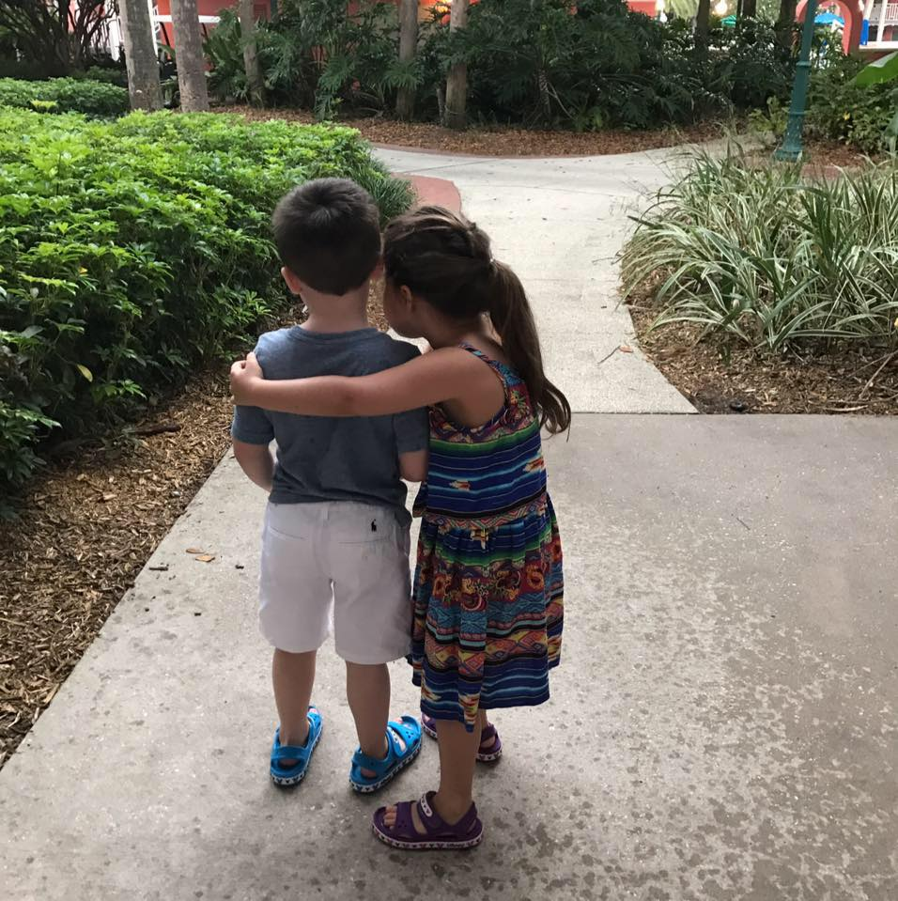
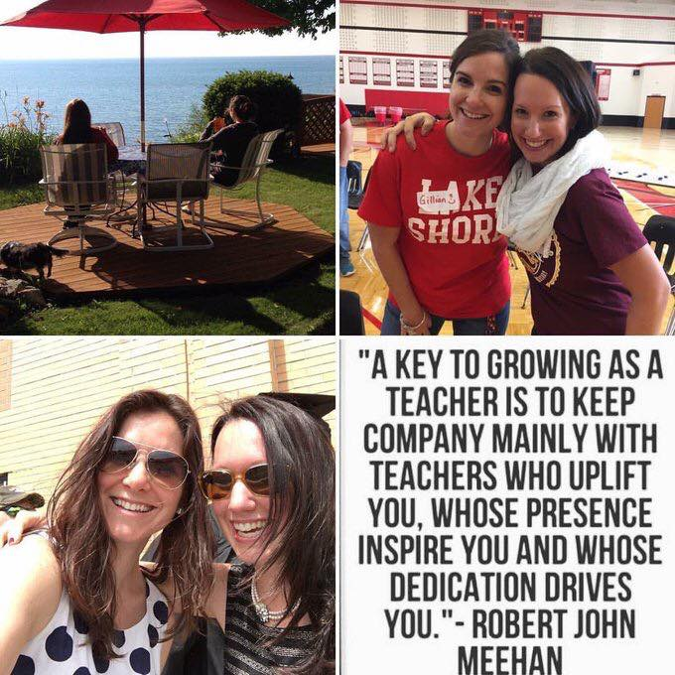
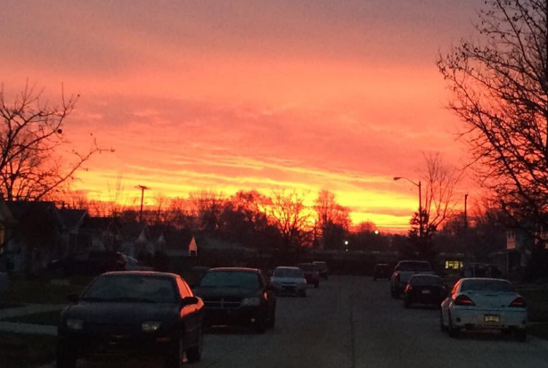
Candela’s Message

Slide 13
Candela’s Message
A’s of Awesome.

